Slide 1

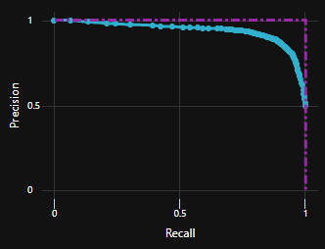
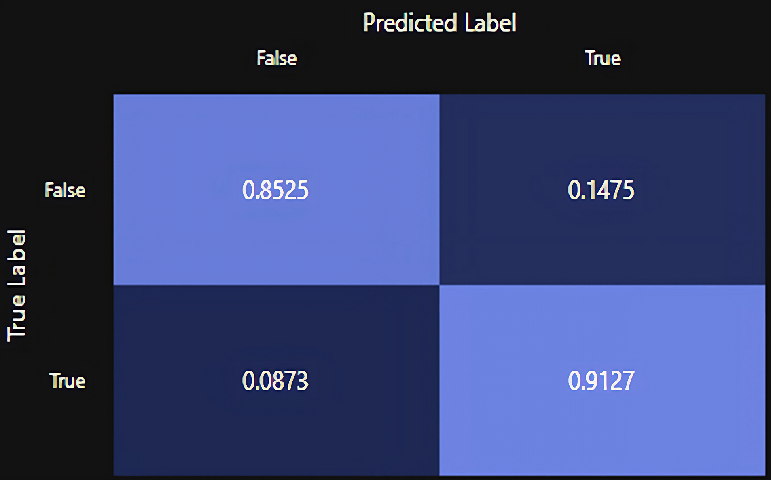





Identifying Veterans at Risk of Suicide Using Machine Learning
Introduction
Veteran suicide is a significant public health issue in the United States, with an average of about 17 veteran suicides per day in 2020 [1]
The U.S. Department of Veterans Affairs(VA) lacks an effective outreach program to distressed veterans, resulting in 7 of 10 suicides with no VA contact [2]
The VA’s calendar-based outreach to a subset of its members can be enhanced through the application of data and machine learning techniques to prioritize outreach to vulnerable veterans who need help at the time they need help
Results
Figure 1 shows the model is maximized for recall in the Precision-Recall tradeoff to identify the important class, suicide, as the proposed use case is to prioritize outreach rather than predict who will commit suicide. The associated cost of misidentifying a non-suicidal person as suicidal is low as misclassified individuals will simply receive a phone call, so we opted for a model with greater recall than precision given the use case.
Figure 2 shows the early phase model can identify the important class (suicide) 91% of the time. This is actionable information that the VA can use to prioritize outreach.
Early results highlight financial problems (e.g., economic stability) and “connectiveness” or “loneliness” attributes may be important to our analytics (e.g., single family vs multi family residence, own vs rent)
Conclusions
By leveraging data, we have built a solution for prioritizing outreach to at-risk individuals
Initial model metrics are promising but with further iterative development we will fine tune the model and remove any inherent bias contained in the input data
As development progresses and we gain access to more high-quality data, we aim to improve the model's ability to generalize to larger populations for widespread application.
85.5%
14.7%
8.7%
91.2%
Fig 1. Precision-Recall Graph
Fig 2. Confusion Matrix
Materials and methods
Created a data sample of 22,000 people from 1 state which includes 12,000 suicides verified by medical examiners data and 10,000 random living citizens
Using the CDC Toolkit[3], the data was categorized into 5 key categories: financial, criminal, legal, relationship, and connectivity issues.
Developed a classification model using Azure for cloud computation and Scikit Learn for model development
Literature cited
1. U.S. Department of Veterans Affairs, Office of Suicide Prevention, National Veteran Suicide Prevention report 2022. Accessed at https://www.mentalhealth.va.gov/suicide_prevention/docs/Office-of-Mental-Health-and-Suicide-Prevention-National-Strategy-for-Preventing-Veterans-Suicide.pdf
2. U.S. Department of Veterans Affairs, Office of Suicide Prevention, VA National Suicide Data Report 2015. Accessed at https://www.mentalhealth.va.gov/docs/data-sheets/OMHSP_National_Suicide_Data_Report_2005-2015_06-14-18_508.pdf
3. Centers for Disease Control and Prevention, Division of Violence Prevention, Preventing Suicide: A Technical Package of Policy, Programs, and Practices. Accessed at https://stacks.cdc.gov/view/cdc/44275
Schafer, Daurio , et al, 2022 “The relationship between anger and suicidal ideation” Journal of Clinical Psychology 78:9
Nicola M. Winkel, MPA, 2022 “Upstream Prevention by Addressing Social Determinants of Health”

